Slide 1
KOHLER | SUSTAINABLE DESIGN INTELLIGENCE
AI Bathroom Design & Spatial Planner
A multi-stage generative intelligence platform unifying natural language input, neural preference embeddings, and CP-SAT constraint optimization.
TRACK 1 TECHNICAL ARCHITECTURE & UI

Slide 2

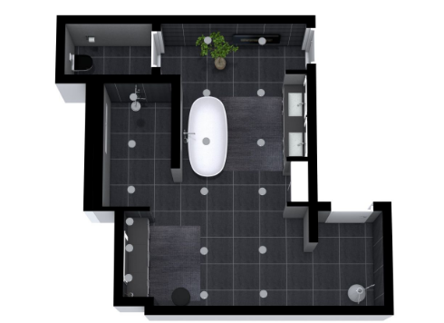
SYSTEM ARCHITECTURE
5-Stage Intelligent Design Pipeline
SmolLM Intent Parsing
01
Extracts budget, room dimensions, and required fixtures into structured JSON.
02
LSTM & Vector Space RAG
Encodes style preferences and retrieves candidate catalog bundles.
03
CP-SAT Optimization
Enforces 100% hard spatial clearances and budget boundary compliance.
04
2D Spatial Floorplan Engine
Generates scaled top-down CAD diagrams rendered to Streamlit timeline.

Slide 3
FRONTEND & PERFORMANCE
Kohler UI & Benchmark Metrics
<1.2s
100%
20
Full Execution Latency
Constraint Adherence
Simulated Kohler Catalog Products
Warm Earth Aesthetic
Versioned Timeline
Kohler cream backgrounds (#FAF8F5), warm typography, and forest green accents.
Sidebar tracks floorplan revisions with prominent "Latest Design" badges.

Slide 4
KOHLER | AI DESIGN STUDIO
Elevating Everyday Sanctuary Rituals
Thank you. Ready for technical Q&A and live system demonstration.
Adit BAgaitkrar
adit2006bagaitkar@gmail.com
PRN: 1262241840

